Slide 1
LIDAR Point Cloud
Lane Marking Detection
Vincent Tran
A20396585

Slide 2
Introduction
The point cloud consists of 430,736 points with latitude, longitude, altitude, and intensity values
The task is to detect which points belong to the lane markings on the road and to find equations to represent those lanes
The intensity values of the lane markings tend to be higher than other points
To make this efficient, we need to filter out as many irrelevant points from the dataset as possible

Slide 3
Methodology
Transform the LLA point to an ENU point
Find the largest plane
Find the candidate points for the lane markings
Find the line equations for the lane markings

Slide 4
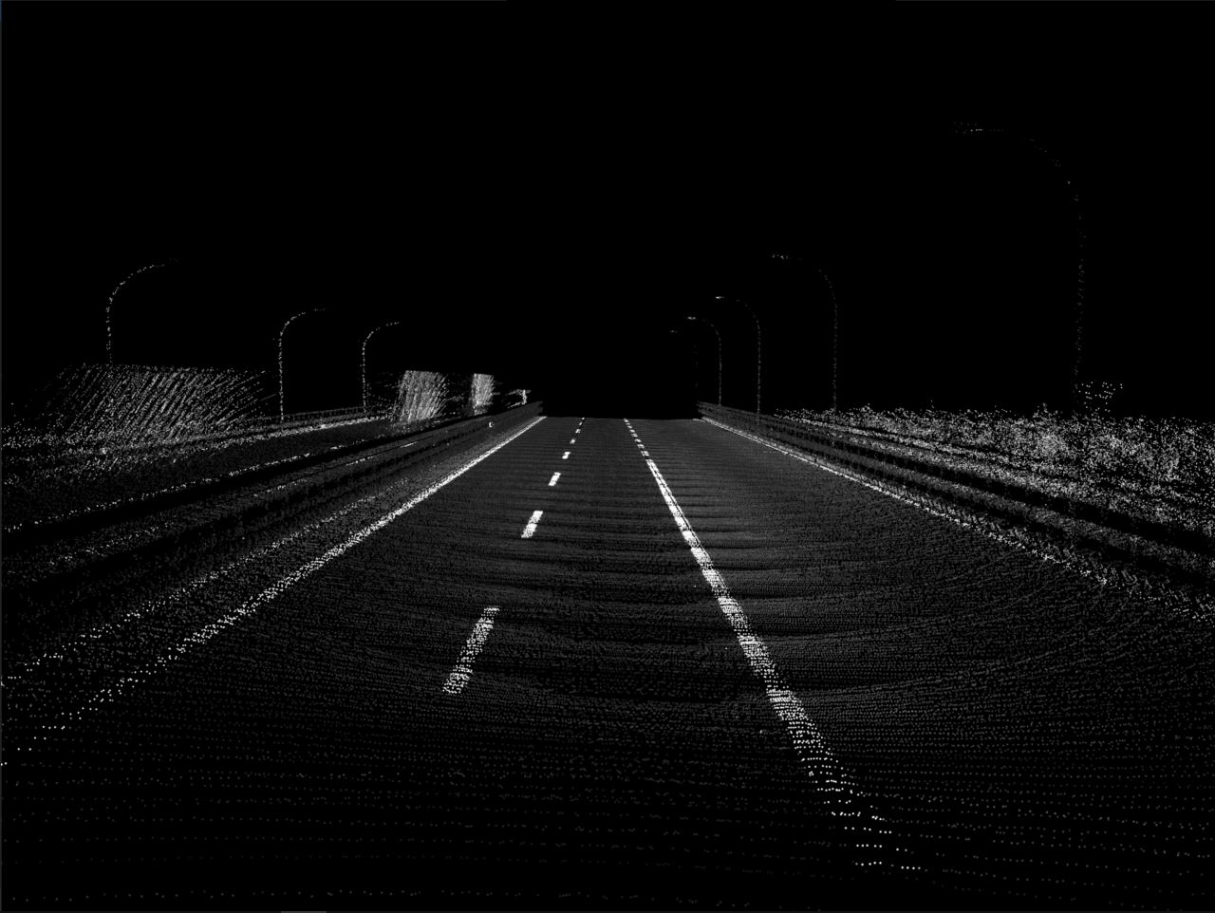
Coordinate Transformations
Transform from LLA to ECEF
Transform from ECEF to ENU
Plot the points

Slide 5

Find Largest Plane
Use RANSAC to find the largest plane in the point cloud
Remove all other points

Slide 6

Find Lane Marking Candidate Points
Filter out points with an intensity value that is higher than 20
Remove all other points

Slide 7

Find Line Equations for Lane Markings
Use RANSAC to find all lines in the point cloud
Remove all other points that do not belong on any of the lines

Slide 8

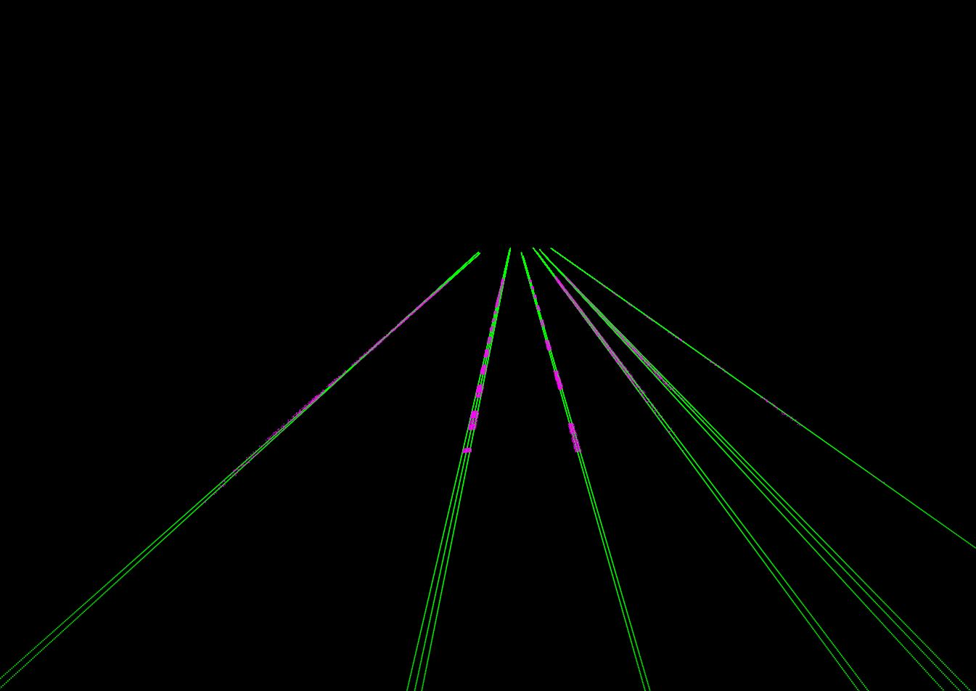
Experiments
Large Line Threshold
Small Line Threshold

Slide 9
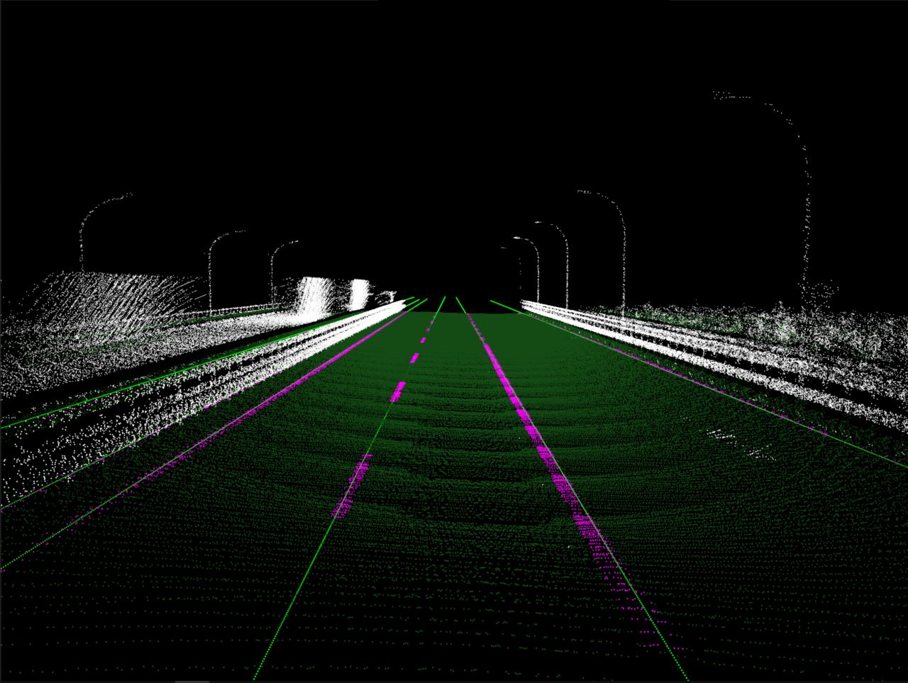
Final Result

Slide 10
Conclusion
RANSAC was used to find the points that belong on the road
Intensity value was used to find possible lane marking points
RANSAC was used to find the line equations for the lane markings
Threshold value for the thickness of a line depends on the thickness of the lane marking

Slide 11
References
PPTK Documentation https://heremaps.github.io/pptk/

